Slide 1
Optical Box for Optical Computing
Technical Details

Slide 2
What is Usual Computing
Numbers
Integer
Ratio
Real
Complex
Rings, Etc.
Operations
Addition or Subtractions
Multiplication or Division
Step-by-step calculations for each math operation

Slide 3
What is Optical Computing
Numbers
Real as Amplitude of Complex EMW Vector
Operations
Rough calculations of Random Vector to Predefined Matrix multiplication
Operates with Complex EMW vectors
Rough Arithmetic Calculations
Do all math calculations parallel with one step for all signal points

Slide 4
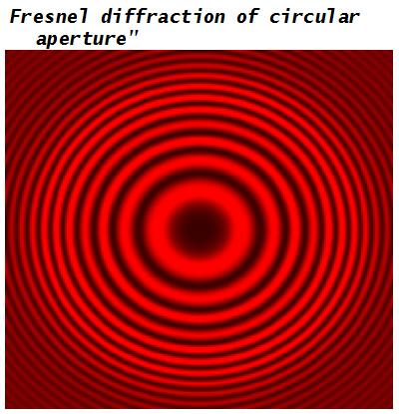
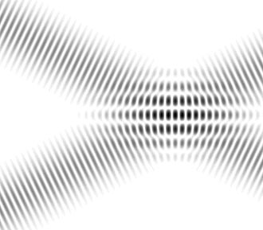
Optical Computing and Optical Commutation Difference
Optical Commutation
Operates with beams of light
To switch light beams modulated by signal from sources to destinations
Light beams switch can be fast and exceed electrical switching
Usually used to telecommunication lines
Optical Computing
Operates with Complex EMW vectors
Rough Arithmetic Calculations
Using Interference and Diffraction of light (EMW)
Do all math calculations parallel with one step for all signal points

Slide 5
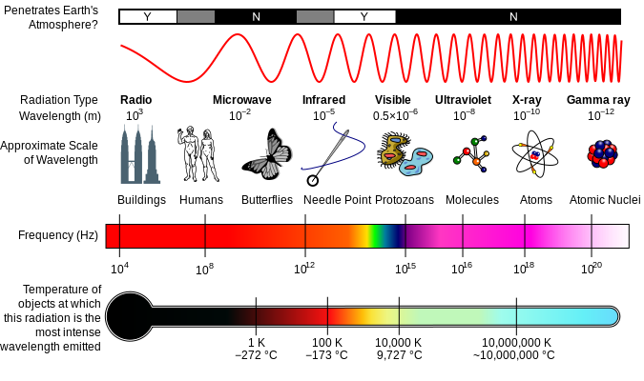
Light for Optical Computing

Slide 6

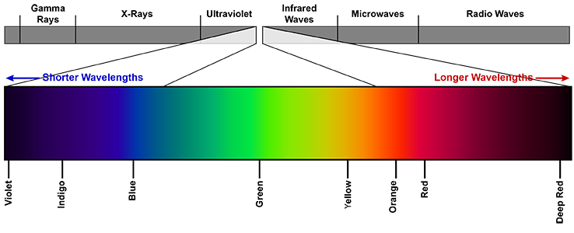
Visible Light for Optical Computing

Slide 7
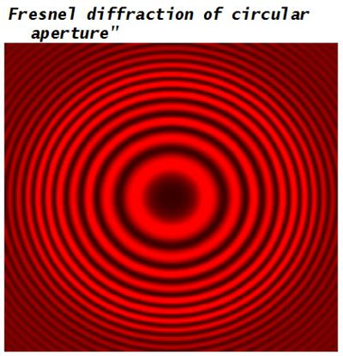
Interference and Diffraction for Optical Computing

Slide 8
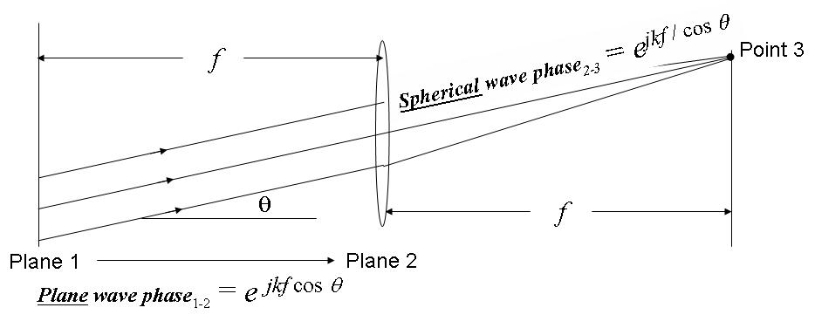
Fourier transforming property of lenses

Slide 9
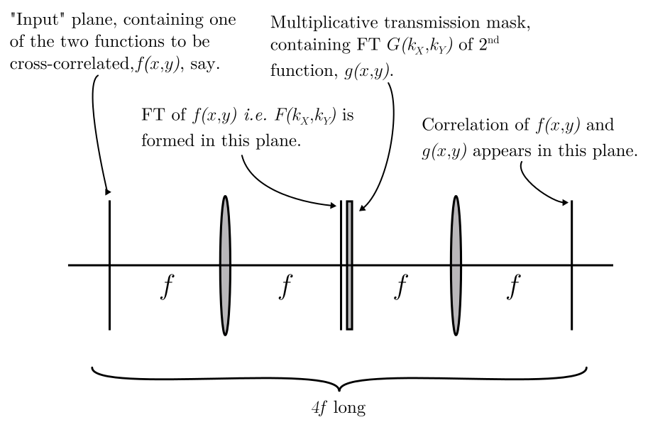
Hardware implementation of the system transfer function The 4F correlator

Slide 10
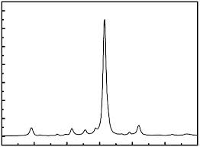
Ideal Light for Optical Computing
Monochrome
Polarized
Single Source

Slide 11
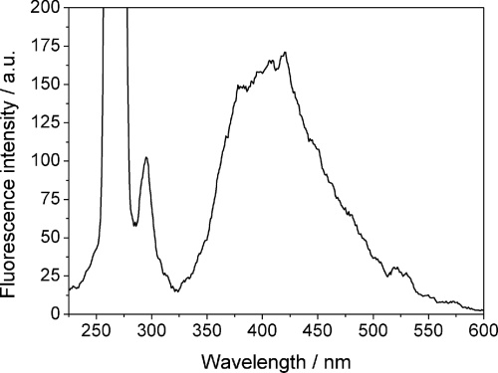
Real Light Properties
Non-Monochrome
Non-Polarized
Many Independent Sources

Slide 12
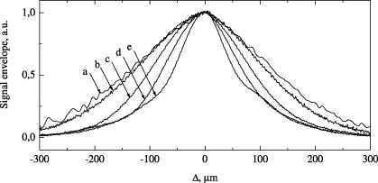
Using Real Light for Optical Computing
Using Light Sources with short spectrum range emitted and small emitted area
Lasers
Laser Diodes
Light Emitted Diodes
Using Light Detectors with short spectrum range accepted
Different Sensor Types
Using Light Filters to short spectrum range
Polarize Light by Filters
Some kind of Films
Some kind of Surface Reflections
Combination all methods above
a
b
c

Slide 13
Light Wave Length Criteria
Spot of Light can not be less of Wave Length, so if using high density chips is better to decrease Light Wave Length
Diffractions and Inference can not exists if sizes of device are small. if sizes of device are small is better to increase Light Wave Length
Red color light have Light Wave Length about 500/1 000 000 000 meter

Slide 14

Fresnel Diffraction

Slide 15


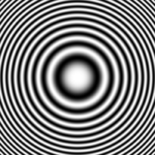
Fresnel Zone Plate Binary & Sinusoidal

Slide 16
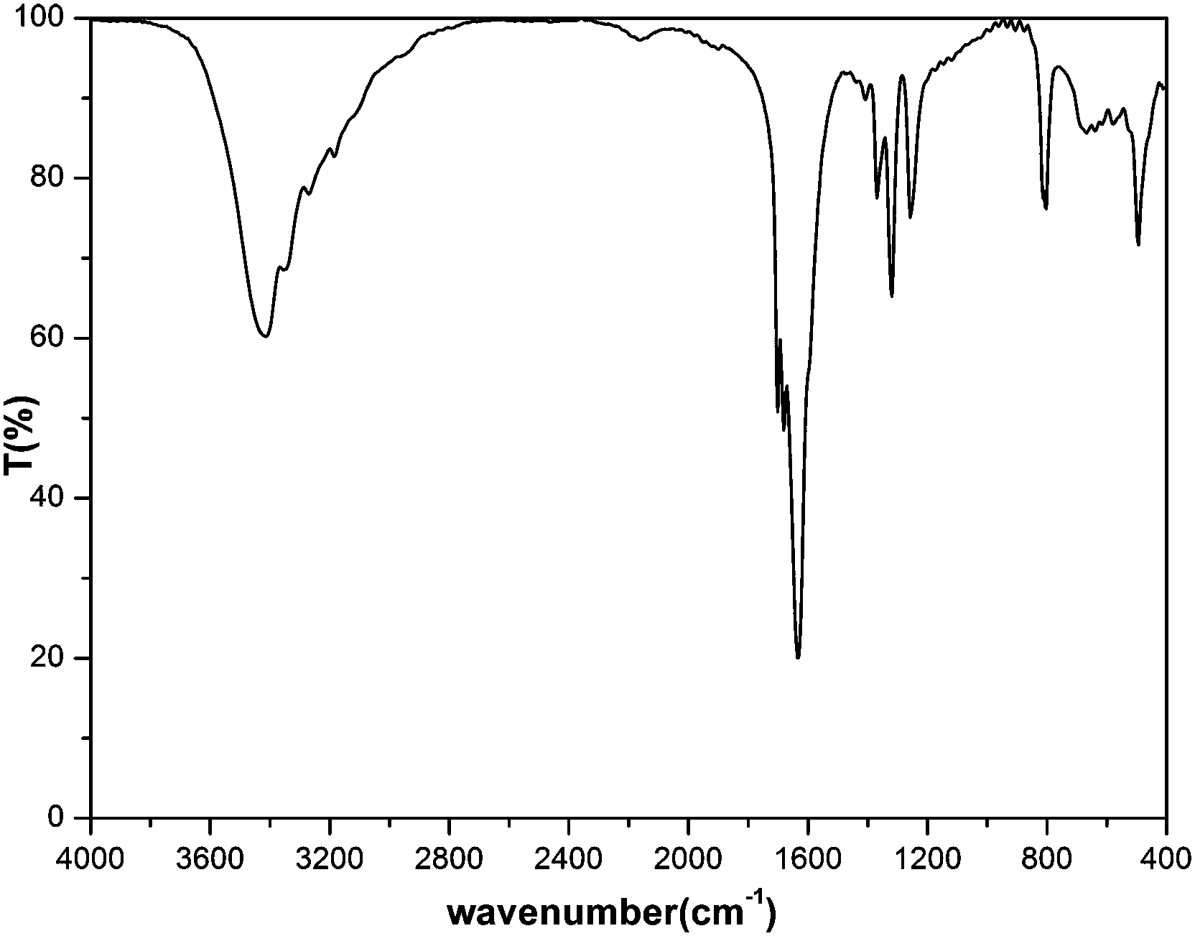
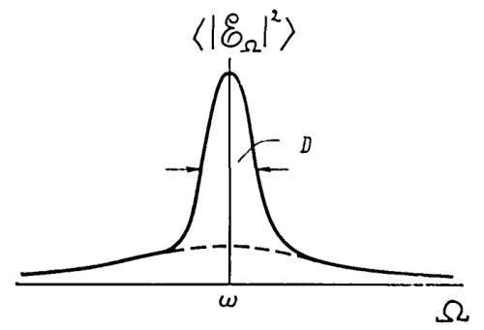
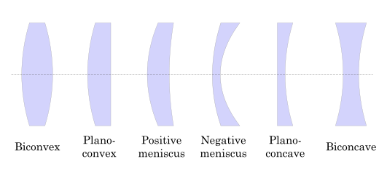
Using Zone Plate for Optical Computing

Slide 17
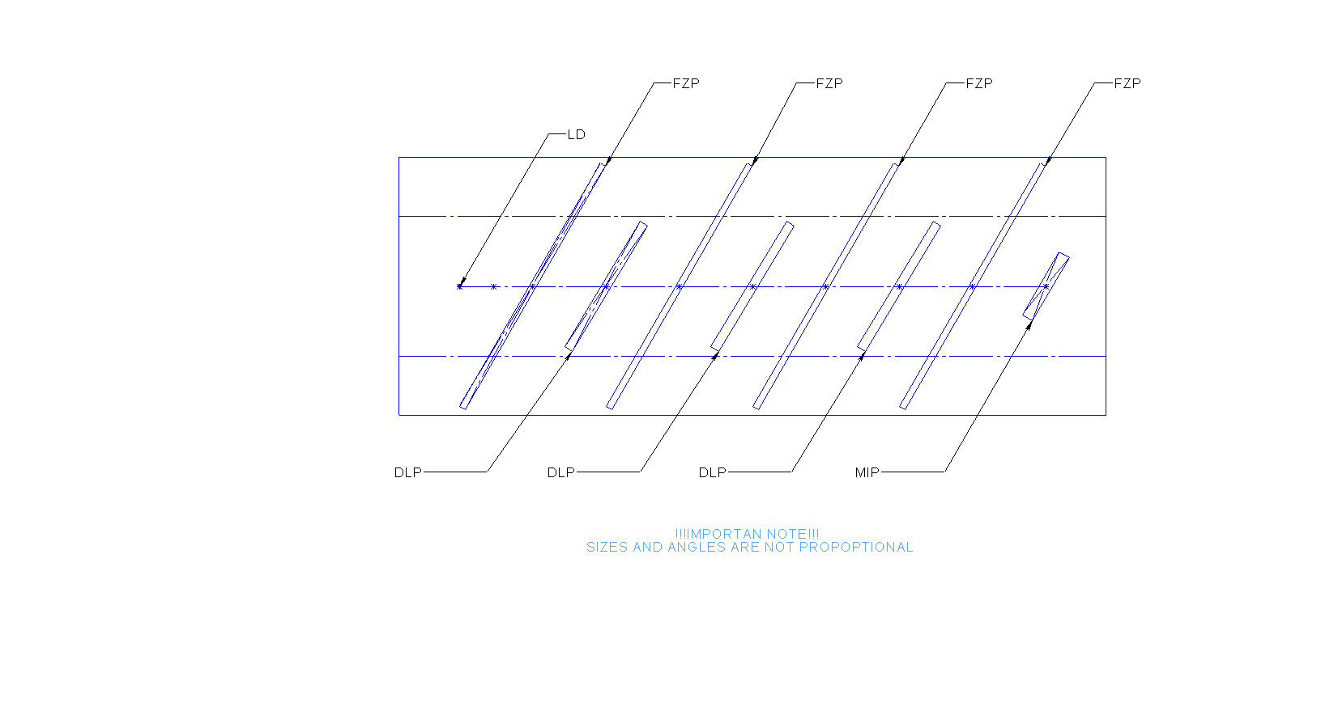
Optical Box Model

Slide 18
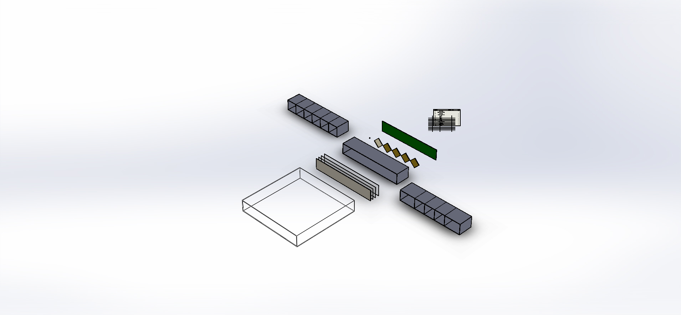
Optical Box Design

Slide 19
Optical Box Design Description
Chips of LD, DLPs and MIS are mount on one side of a Circuit Board in row with equal step. LD and MIP are placed at left and right DLPs are placed in the middle.
The Circuit Board is places at one side of a Frame
At another side of the Frame placed a Film with printed FZPs, a Polarizing Filter, a Color Filter and a Mirror
Sizes of the Circuit Board, the Film with FZPs, the Polarizing Filter, the Color Filter and the Mirror are equal
A number of printed FZPs is equal a number of DLPs plus two half-sized FZPs for LD and MIS
To remove wrong light rays LD, DLPs, FZPs and MIS have collimator shutters
Light from LD multiply time pass thru FZP and reflect from Mirror on a second side of the Frame or reflect from DLP on a first side of the Frame until MIS catch a ray.
Distances between a pair of LD-FZP or FZP-DLP or FZP-MIS are equal
DLP or MIS can be combined from number of chips
Some DLP can be replaced by mirrors to reduce number of DLP chips

Slide 20
Optical Box Design Description
A number of single Optical Boxes can by stacked or combined
DIPs and MISs can be placed as 1D or 2D arrays
Optical Box can be equipped by
An internal memory to fast read MIS values and write DIPs values
An embedded computer with embedded software
An Ethernet port
A front panel
A power supply
19’’ rack mount kids

Slide 21
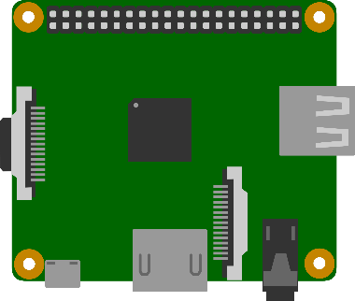

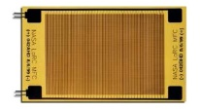
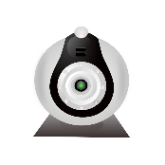
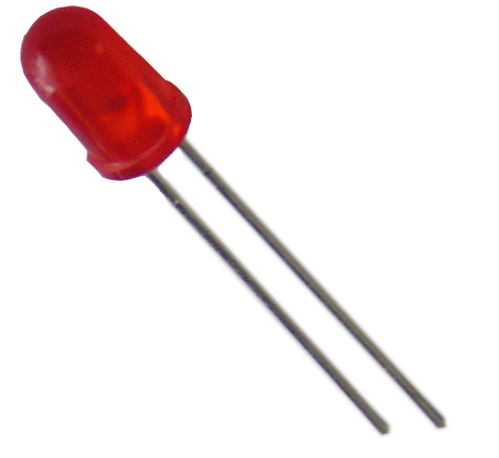
Embedded Hardware Architecture
Ethernet
Serial
HDMI
USB

Slide 22
Embedded Software Architecture
TCP/IP
Localhost
VLC
MOTION

Slide 23



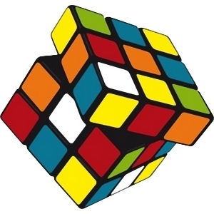
Optical Box Math Model

Slide 24
DLP Usage Notes
Usual DLP chip micro-mirrors have 3-state (3 micro-mirror reflection angle)
Parked
On or Off
Technology to generate grayed image by fast switch between On and Off states used by video projectors is not applicable by Optical Computing.
Solution Ways in case using DLP chip of micro-mirrors with limited states is
Do calculations with 1-bit numbers and apply iteration math algorithms to up precision
Use group of micro-mirrors to generate gray color
Another way to use micro-mirrors with 3-state in binary mode in case of slow MIS is
Transparent = Parked state
Opaque = fast random switch between On and Off states.
fast random switch between two states will generate average energy picture caused random diffraction pictures cached by MIS

Slide 25
Optical Box Math
Optical Box Design do parallel math calculations of signals on DLP
Optical Box Design do not calculate Fourier transforming
Optical Box Design do calculate Some (Unknown, depended from device implementation) Matrix Multiplication transforming of signals on each FZP
Because Optical Box Design has more then two DLP
Reverse of Unknown Matrix
Can be calculated by experiments (during Optical Box Calibration)
Can be saved for future use in embedded memory of Optical Box
Can be used for calculation needed
One DLP (if light is high polarized) or two DLP (if light is low polarized) can be used to correct total matrix production for calculation needed like Fourier transforming, Walsh-Hadamar transforming and etc.

Slide 26
Optical Calculations Precision
Fact
Calculation with using optics calculations gives rough results
Solution Ways
Same algorithms like sorting, brute force, branch-and-bounds and etc. do not need precision for all results but selected only. Selected results can by calculated traditional way.
There are many step-by-step math iteration algorithms exists to up precision as needed
Conclusion
Rough results can by used effectively

Slide 27
Thank You
Contacts
Dmitry Protopopov, Moscow, Russia dmitry@protopopov.ru +7 916 6969591
Taras Kovtun, Boca Raton, FL, USA boss@rbadesign.us

